Slide 1
0x106 – Engineering Ethics & Computer Security
ECED4406 – Computer Security
Dr. Colin O’Flynn
Dalhousie University.

Slide 2
Ethics in Computer Security
Professional Engineering Ethics
Engineers, in the fulfillment of their professional duties, shall:
Hold paramount the safety, health, and welfare of the public.
Perform services only in areas of their competence.
Issue public statements only in an objective and truthful manner.
Act for each employer or client as faithful agents or trustees.
Avoid deceptive acts.
Conduct themselves honorably, responsibly, ethically, and lawfully so as to enhance the honor, reputation, and usefulness of the profession.

Slide 3
Computer Security Ethics
Safety of Public is always most critical – but this may conflict with laws & commitment to commercial entities.

Slide 4
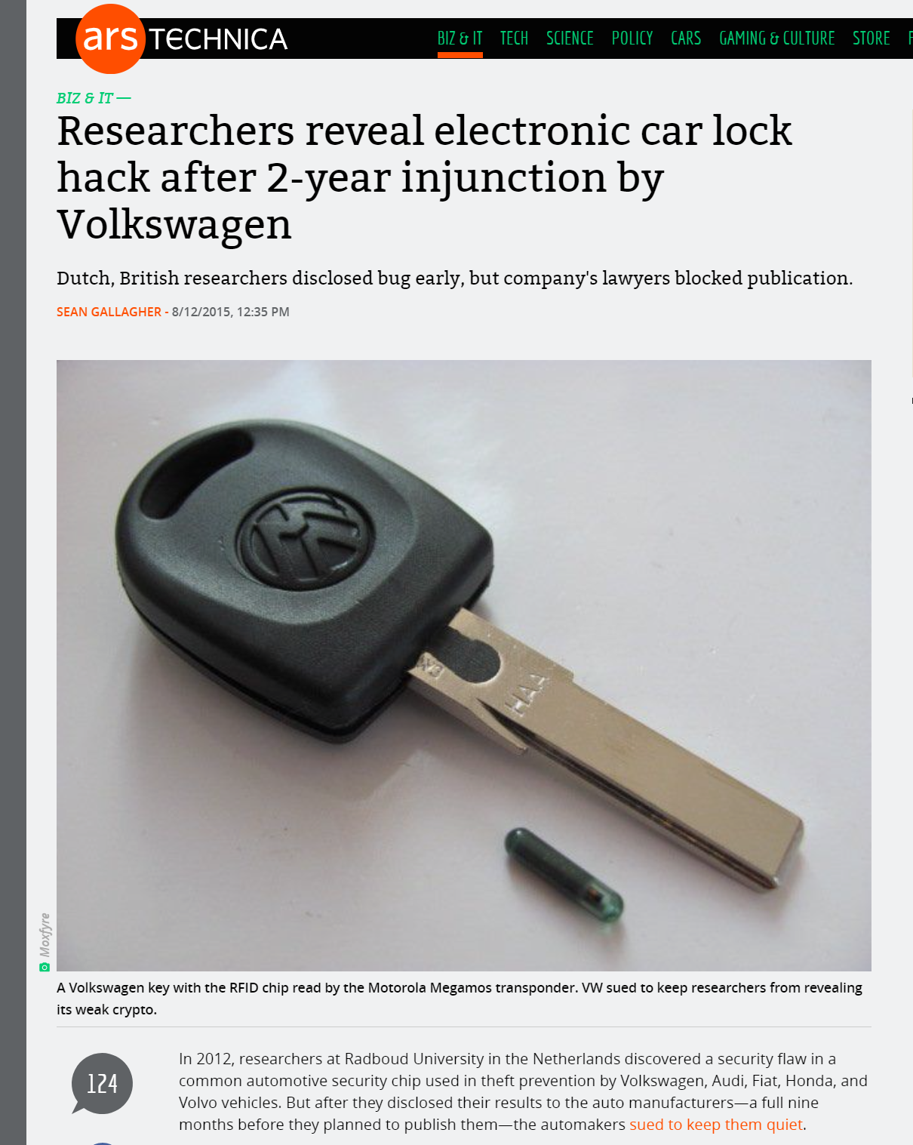
Example #1: Electronic Car Locks
Transponder key uses an algorithm that isn’t very secure.
Researchers want to publish this to show the flaws.
It’s possible people already know about this flaw (many such disclosures turn out to be known in private circles – cybercriminal, government, etc).
https://arstechnica.com/information-technology/2015/08/researchers-reveal-electronic-car-lock-hack-after-2-year-injunction-by-volkswagen/

Slide 5


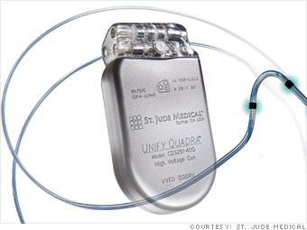
Example #2 - Medical Device Security
Scene: You are a medical device manufacture.
Your revenue is $5.6 billion in 2014.

Slide 6
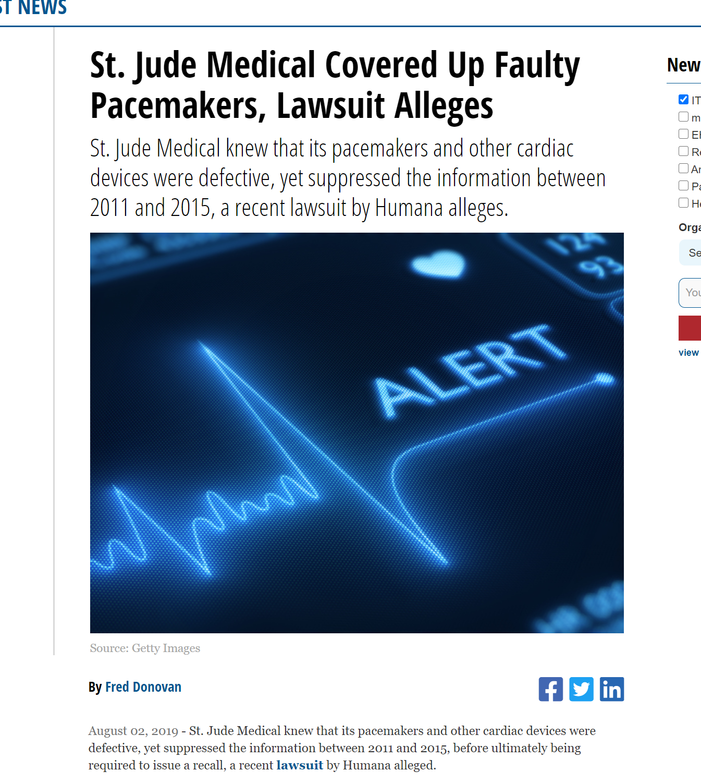
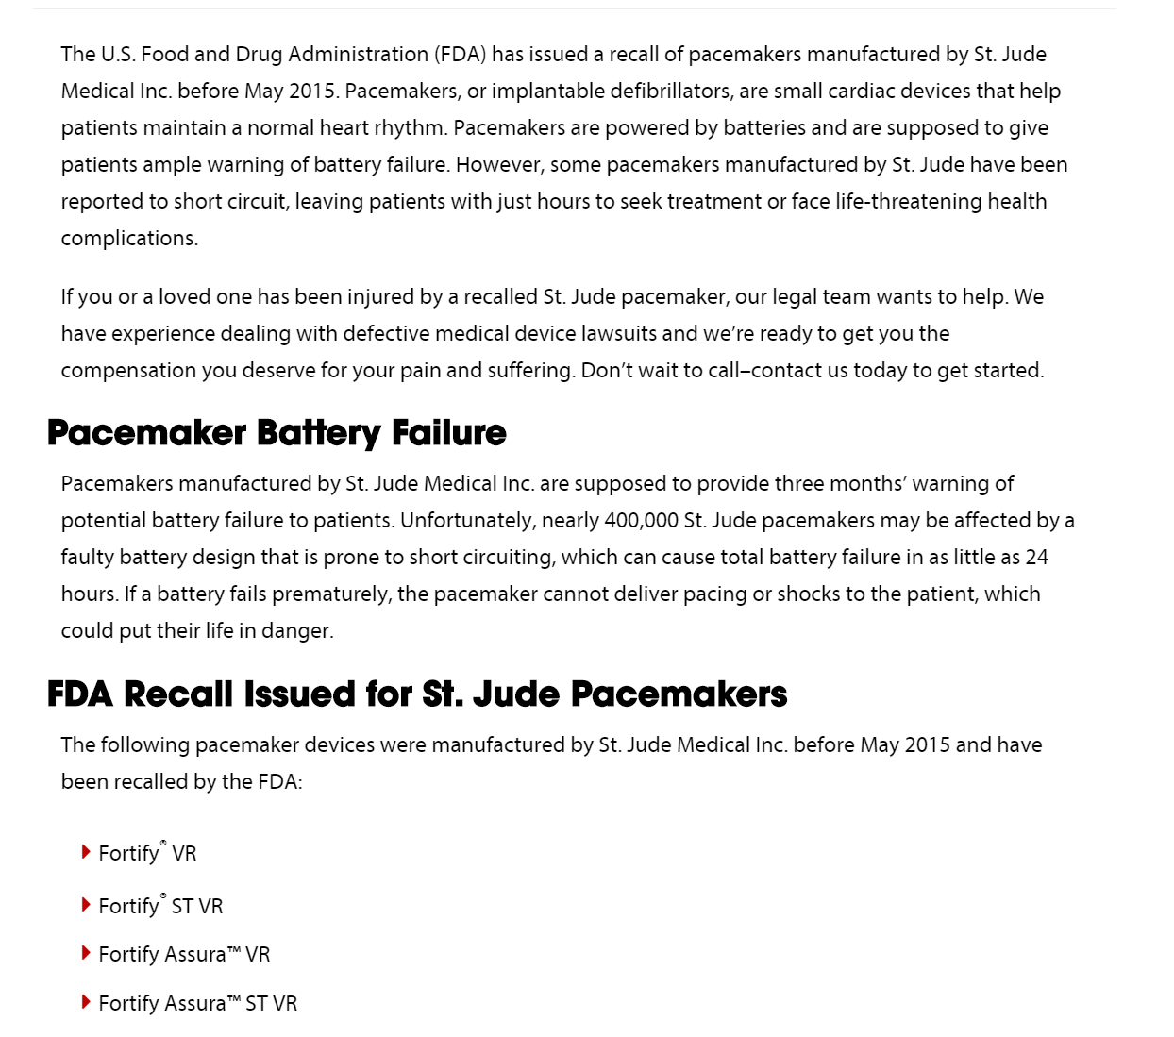
Your company is… very revenue focused…
Example #2 Cont’d
https://hitinfrastructure.com/news/st.-jude-medical-covered-up-faulty-pacemakers-lawsuit-alleges

Slide 7

Various Researchers Disclose Security Flaws to You…
Example #2 Cont’d
No real disclosure process.
No process to “fix” issues in certain timeframe.
Critical flaws disclosed that could affect customers…

Slide 8
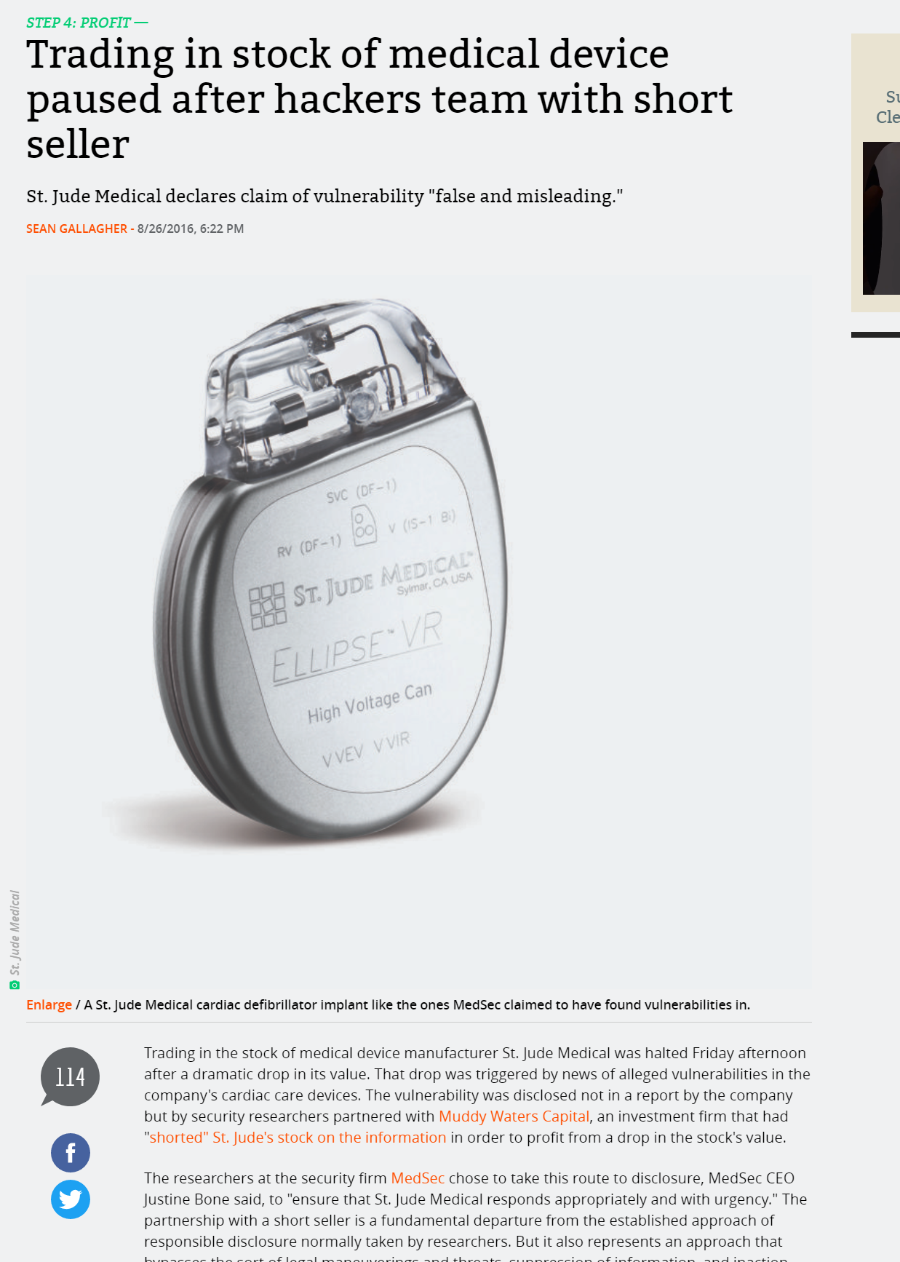
Possible Solution
Example #2 Cont’d
“Attack” on stock of St. Jude medical:
Release vulnerability report showing security issues.
Hedge fund “shorts” the stock right before this (makes money off stock falling).
Objective
St. Jude cares about stock price → force a reason for change.
At the time – still limited rules around security disclosures.
https://arstechnica.com/information-technology/2016/08/trading-in-stock-of-medical-device-paused-after-hackers-team-with-short-seller/
https://blog.erratasec.com/2016/08/notes-on-that-stjudemuddywattersmedsec.html#.X3Mw0WhKgcE

Slide 9
Ethics is Rarely Black & White
Service to public is paramount – here they operated outside of normal disclosure framework.
How should you operate (assuming things are “working normally”)?

Slide 10
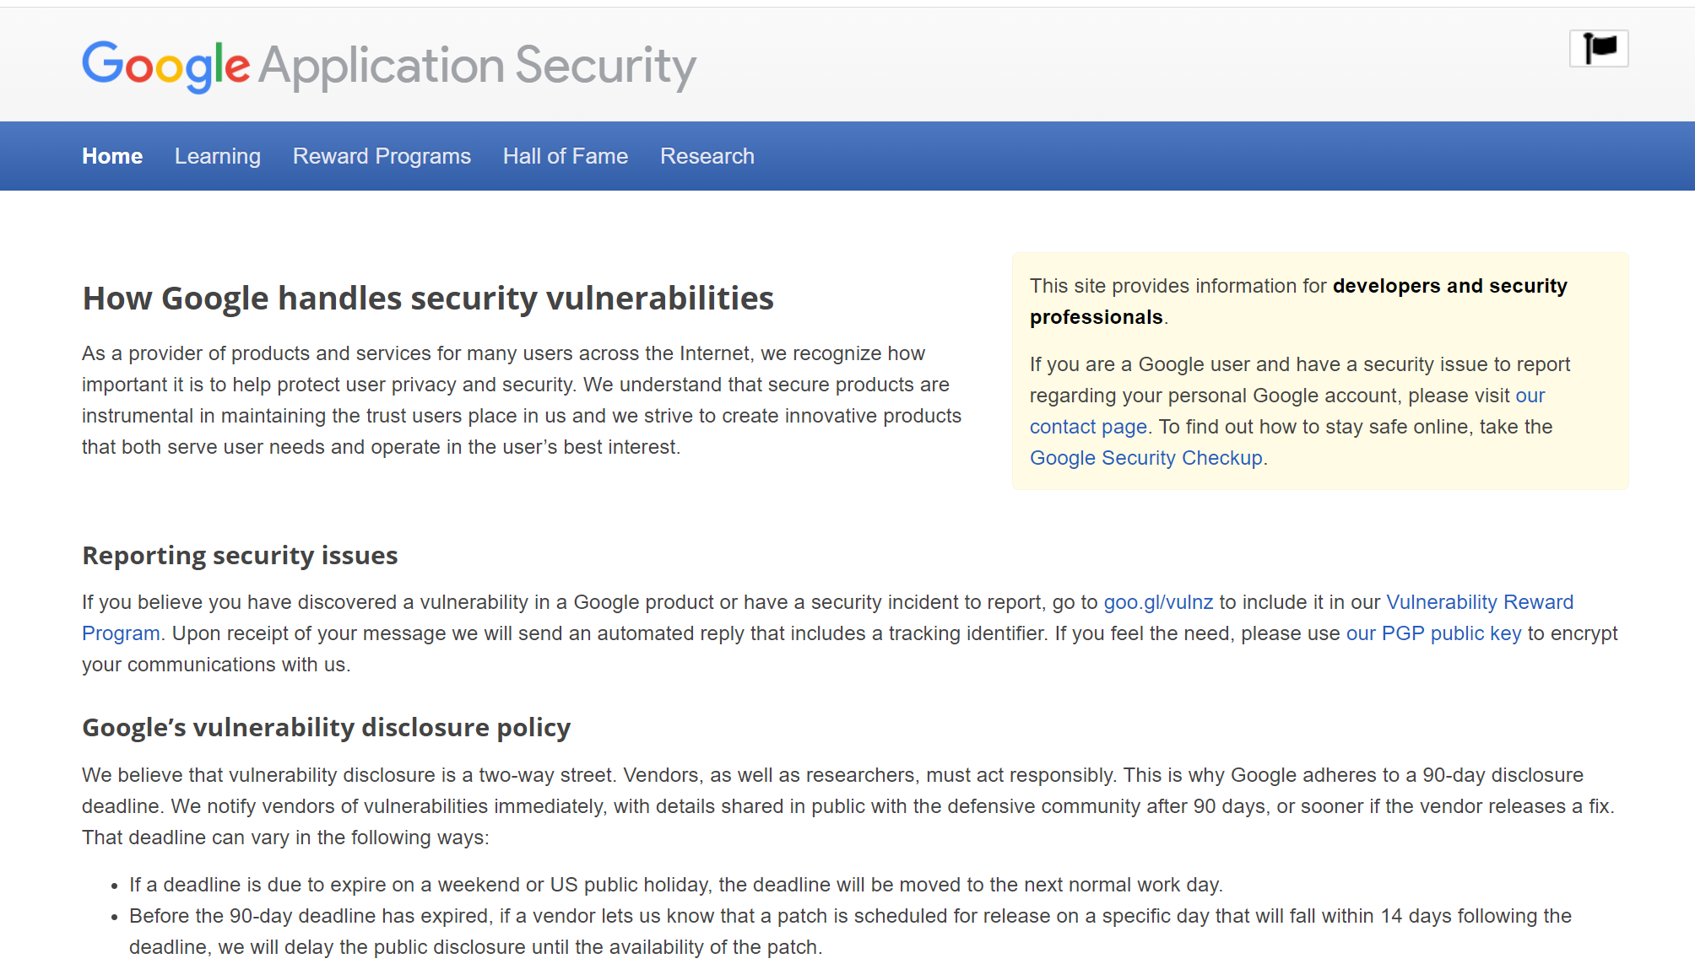
Normal Disclosure Process
Disclosure means telling the affected party (company) about your results.
Give them time to fix the problem.
You reveal your research to the world as “something to build on”.
https://www.google.com/about/appsecurity/

Slide 11
What is Disclosure Timeline?
Typically two conflicting requirements:
Company → Would prefer not to lose face.
You → Want recognition for your work.
“Standard” is around 90 days (3 months), typically enough time to fix… at least for software.

Slide 12
Disclosure Timeline Trickiness
What if company does not agree to disclosure?
What if disclosure timeline is years or device is unfixable?
What if company sues you, threatens injunction, etc?

Slide 13
Company Side Concerns
Why did this person do this work?
Do they want fame from the work if not part of some paid engagement?
What do they want from us?
Are they trying to get money out of us?
Can we offer them a consultancy or to buy the report etc?
Is it extortion or research?
How flexible are they in publication plans?

Slide 14
Typical Result - Disclosure to Consultancy
A company may offer to buy your research.
Effectively compensating you for the time – as if they had asked you to perform the work.
This will normally mean you sign a contract including either non-disclosure or more limited disclosure.
Normally the case for independent security researchers (i.e., not affiliated with university or company).

Slide 15
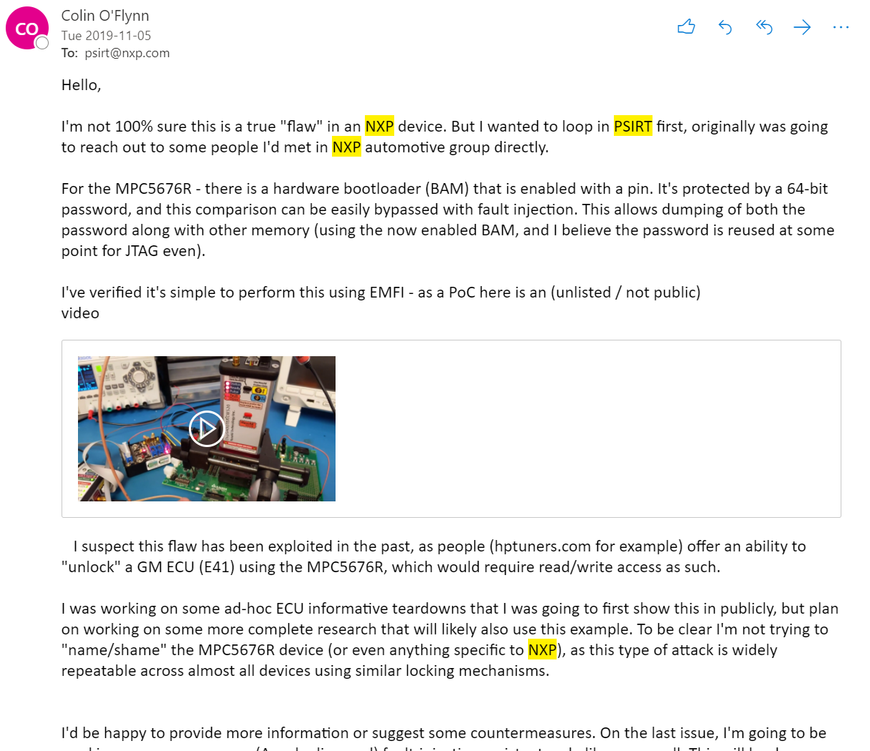
Disclosure Example – ECU Bootloader
#1 Find “Product Security Incident Response”
#2 Short summary of issue.
#3 More details (this report was done before full report was written, video URL removed here).
#4 Where I’d like to go with it (publish paper).
#5 Some friendly comment about not trying to make their life more difficult.

Slide 16
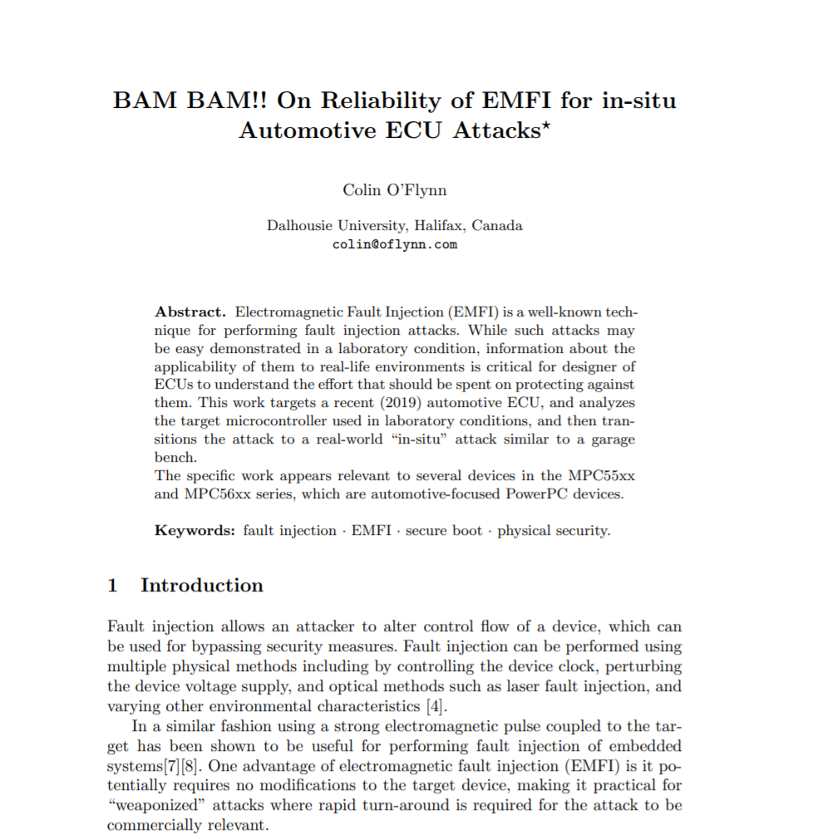
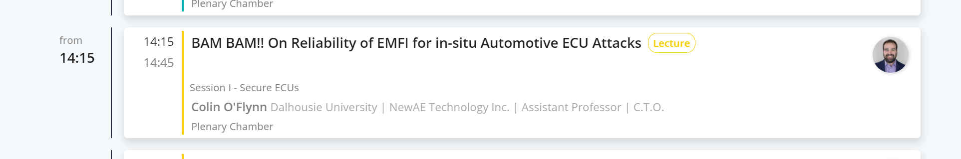
Results of Disclosure
As NXP knows the product & industry best – they raised some questions to me.
Several discussions on answering questions to help understand limitations & possible countermeasures.
Limited changes to final publication requested.
To be presented at ESCAR EU (Nov / 2020)
https://eprint.iacr.org/2020/937.pdf

Slide 17
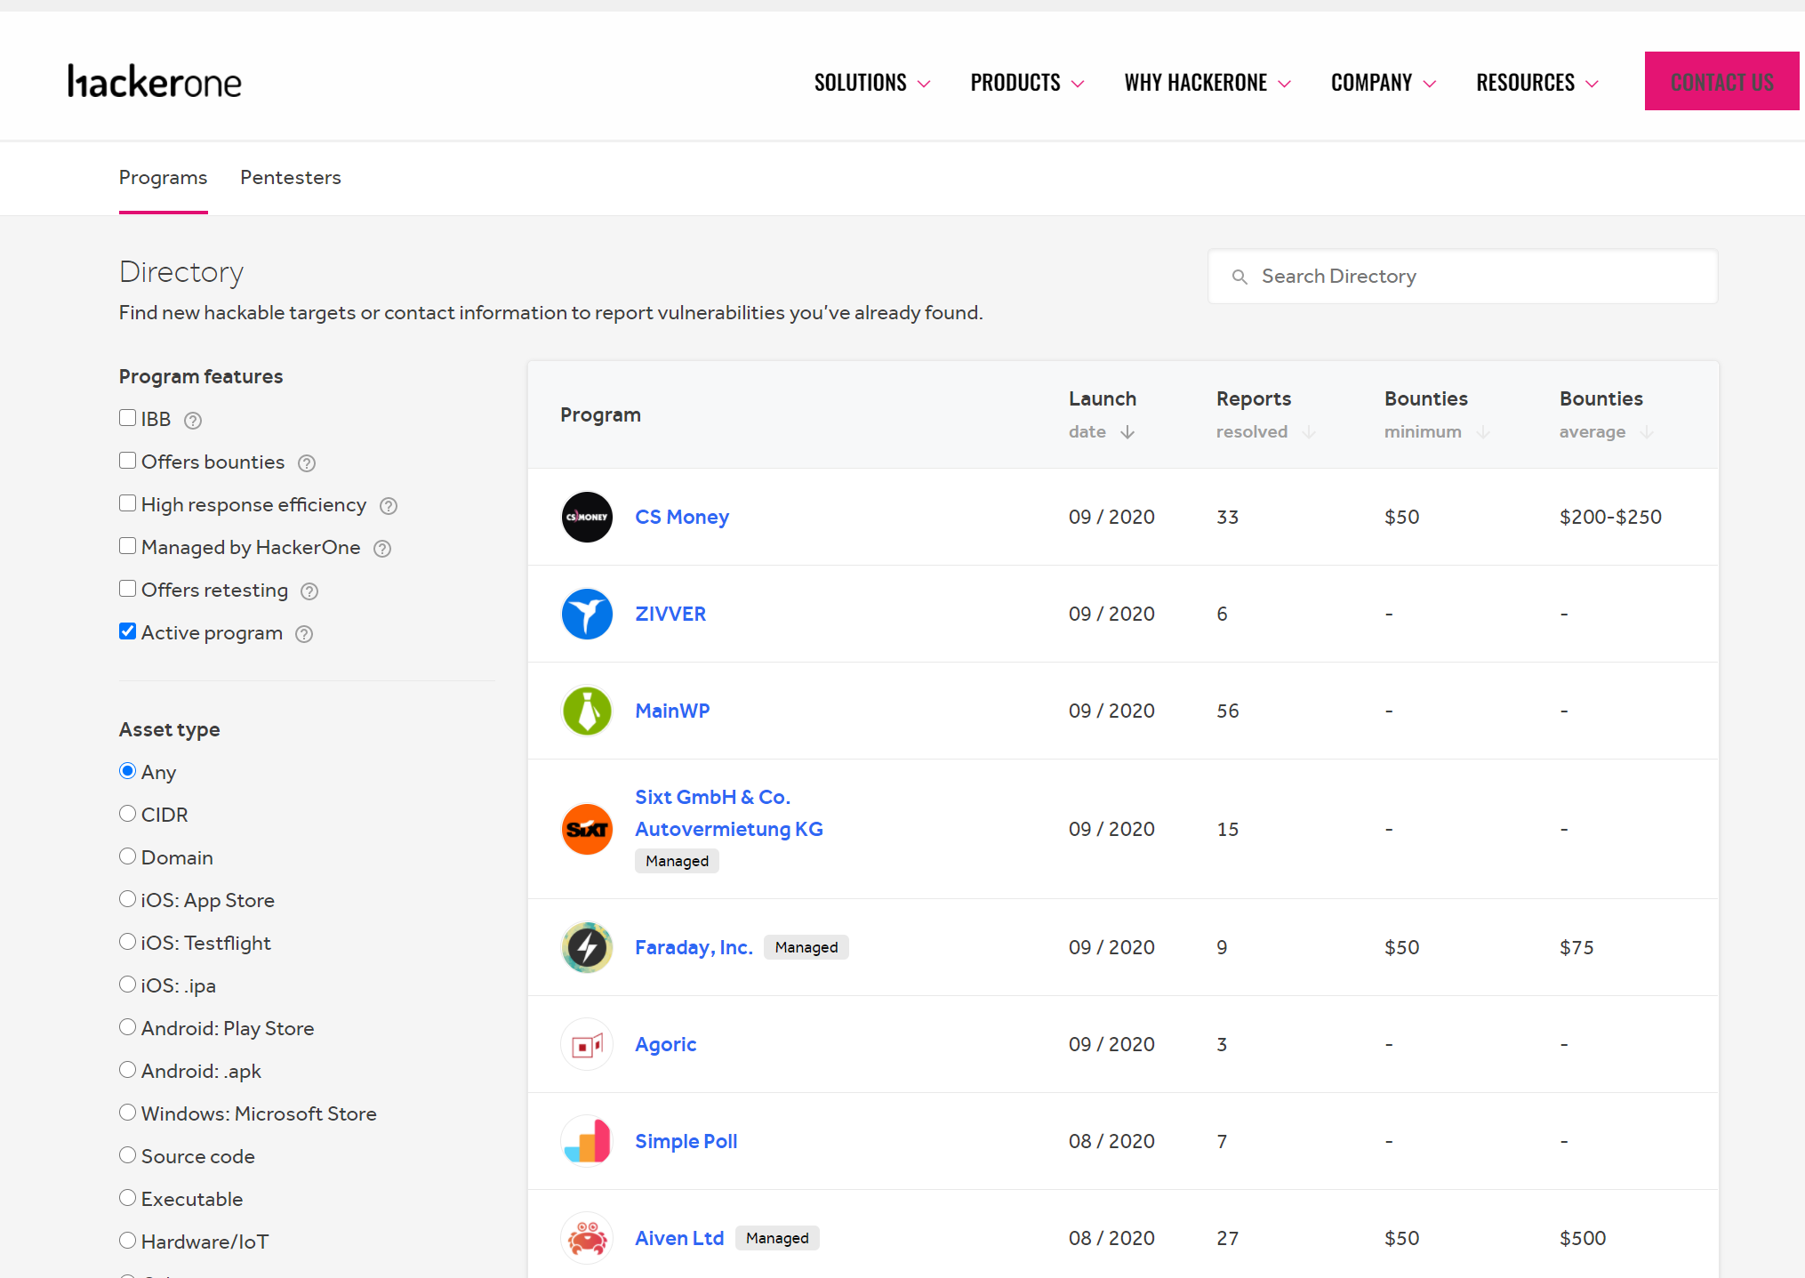
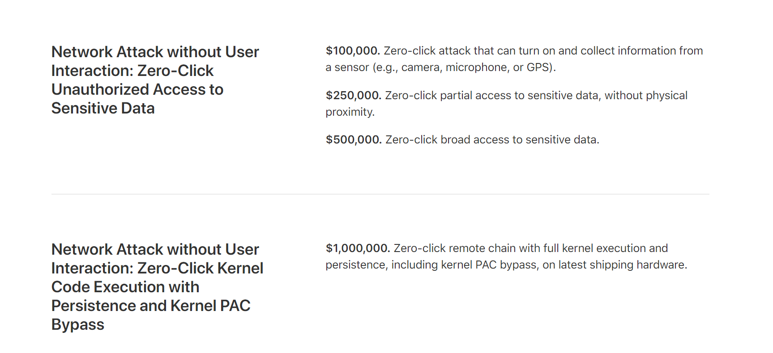
Bug Bounties – being rewarded for disclosure
https://hackerone.com/directory/programs
https://developer.apple.com/security-bounty/payouts/

Slide 18
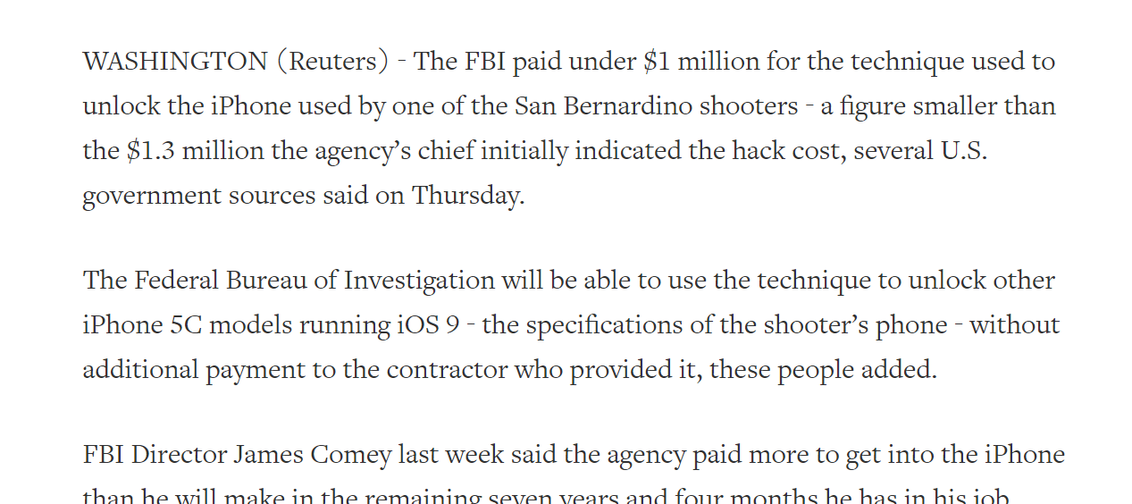
Bug Bounty Issues…
What is “value” of exploit – is bug bounty reasonable?
Phone security bypass are highly sought after by law enforcement.
https://www.reuters.com/article/us-apple-encryption-idUSKCN0XQ032

Slide 19
Remember your ethical duties in determining the path.
Professional Engineering Ethics
Engineers, in the fulfillment of their professional duties, shall:
Hold paramount the safety, health, and welfare of the public.
Perform services only in areas of their competence.
Issue public statements only in an objective and truthful manner.
Act for each employer or client as faithful agents or trustees.
Avoid deceptive acts.
Conduct themselves honorably, responsibly, ethically, and lawfully so as to enhance the honor, reputation, and usefulness of the profession.

Slide 20
Disclosures (Public or Otherwise)
We all want to be recognized for the work – but disclosures need to be accurate and realistic.
For example:
You find a way to unlock a door lock, but it requires access to internal parts of the lock not accessible from the front-side.

Slide 21
Computer Security Ethics
General engineering ethics apply to computer security research.
Safety of public is paramount in everything you do.
But must be reasonable if you decide to disclose without permission – a security issue that might cause a slight possibility of financial loss is different from one that could cause loss of life for example.
Computer security laws are still changing.

Slide 22
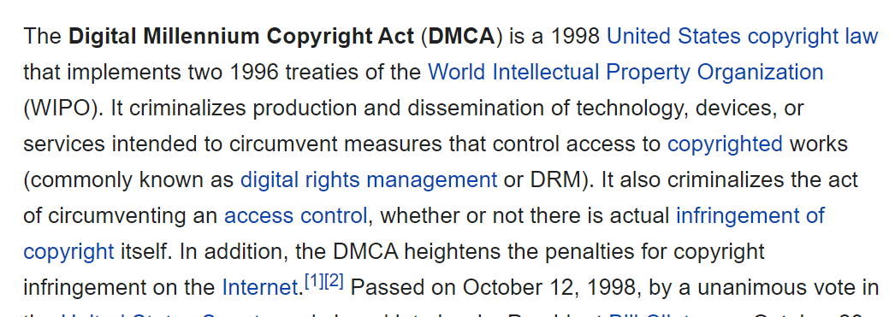
Computer Security Laws
DMCA is probably most well-known (but US based) law:

Slide 23
DMCA Issues
The act of bypassing an electronic lock became criminal, regardless of the end goal.
What if manufacture locks you from using 3rd party repair services for example?
Over time various exemptions added, most recent additions (per EFF article):
People who repair digital devices, including vehicles and home appliances, will have more protection from legal threats.
Filmmakers, students, and ebook creators will be able to use video clips more freely.
People can now jailbreak and modify voice assistant devices like the Amazon Echo and Google Home, as they can with smartphones and tablets.
Security researchers will have more freedom to investigate and correct flaws on a wider range of devices.
https://www.eff.org/deeplinks/2018/10/new-exemptions-dmca-section-1201-are-welcome-dont-go-far-enough

Slide 24
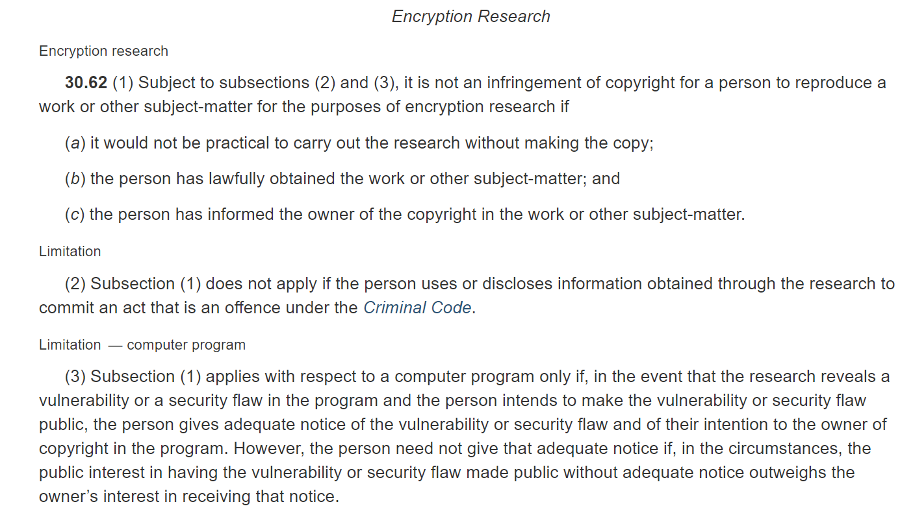
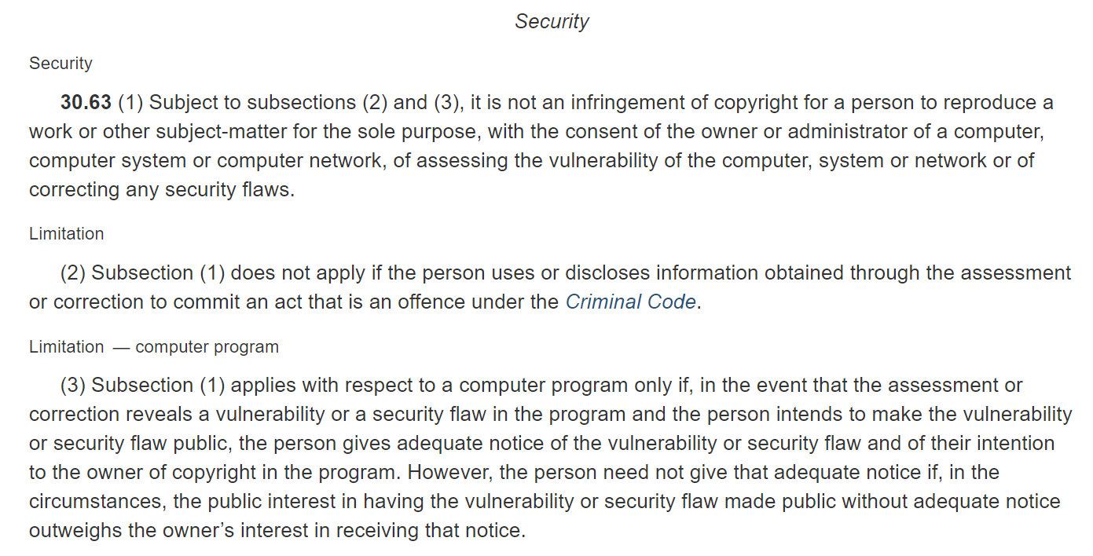
Canadian Bill C-11 (Copyright Modernization Act)
in the event that the assessment or correction reveals a vulnerability or a security flaw in the program and the person intends to make the vulnerability or security flaw public, the person gives adequate notice of the vulnerability or security flaw and of their intention to the owner of copyright in the program. However, the person need not give that adequate notice if, in the circumstances, the public interest in having the vulnerability or security flaw made public without adequate notice outweighs the owner’s interest in receiving that notice.
https://laws-lois.justice.gc.ca/eng/annualstatutes/2012_20/fulltext.html

Slide 25
Security Research (General Caveats)
All of this talk has focused on devices you own. What about network security testing?
Performing tests on a device that is not your own can cause immediate criminal charges, even if “just exploring”.
Access of computer systems “beyond your allowed permissions” will cause you trouble.

Slide 26
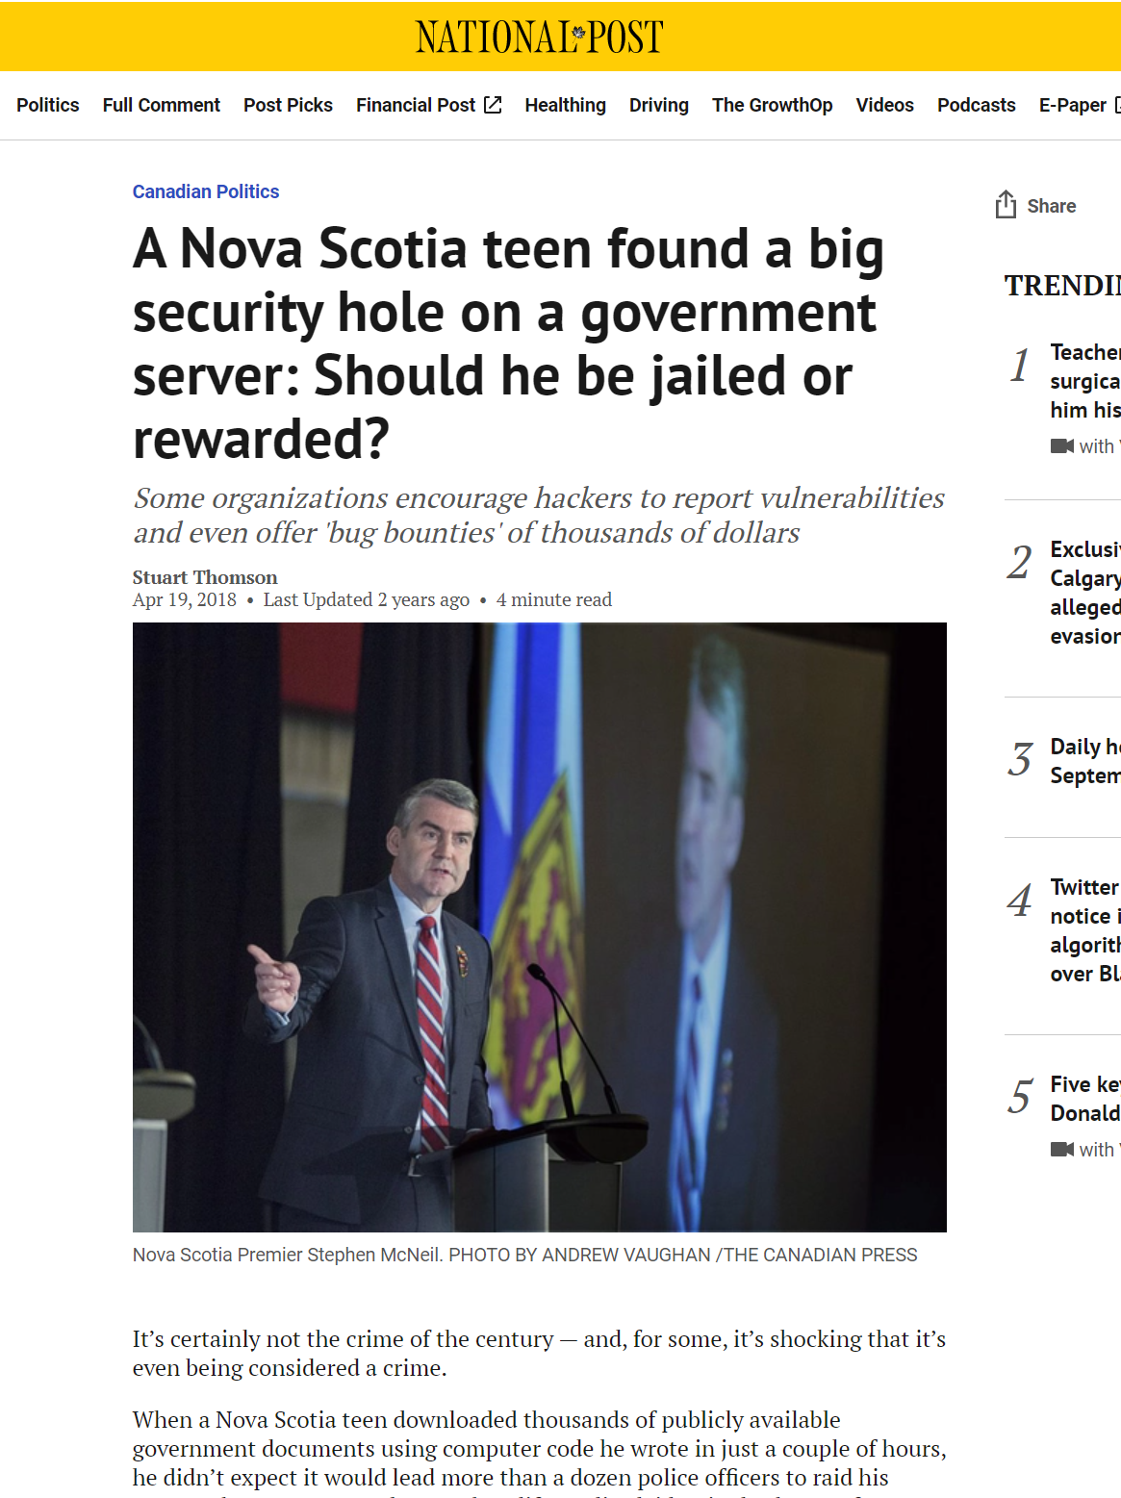
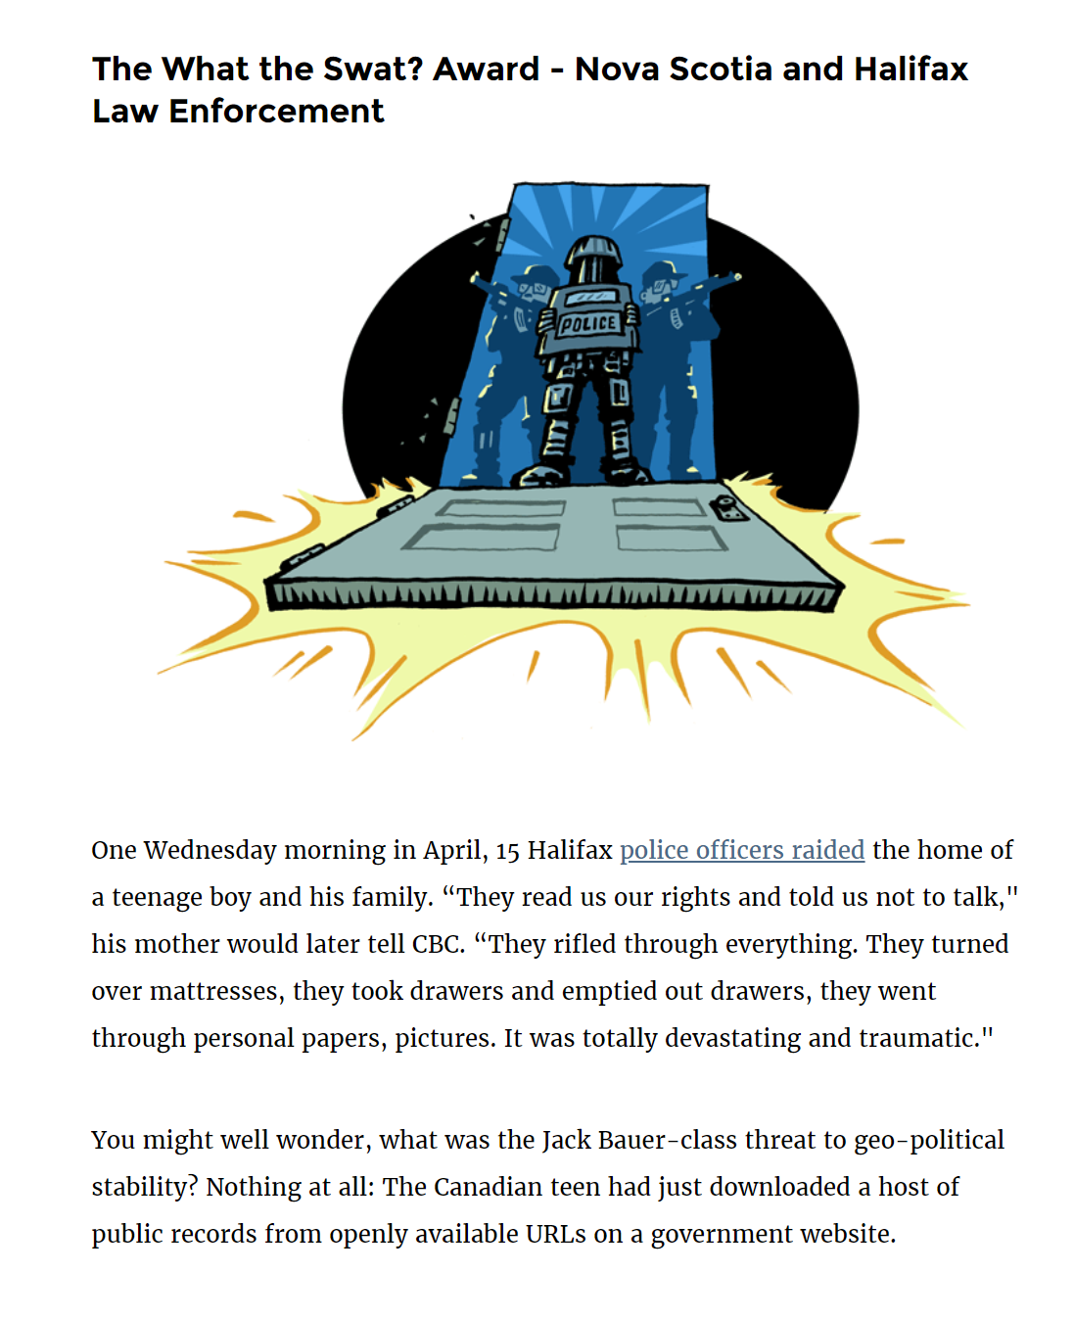
Warning: Embarrassing Governments can cause you a lot of trouble regardless of laws…
The website created to host the province’s public records was designed in such a way that every request and response had a nearly identical URL and placed no technical restrictions on the public’s ability to access any of the requests. This meant that regular public records requests and individuals’ requests to access government files about them, which included private information, were all stored together and available on the internet for anyone, including Google’s webcrawler, to access. All that was necessary was changing a number identifying the request at the end of the URL.
https://nationalpost.com/news/politics/a-nova-scotia-teen-found-a-big-security-hole-on-a-government-server-should-he-be-jailed-or-rewarded
https://www.eff.org/deeplinks/2019/03/foilies-2019#novascotia

Slide 27
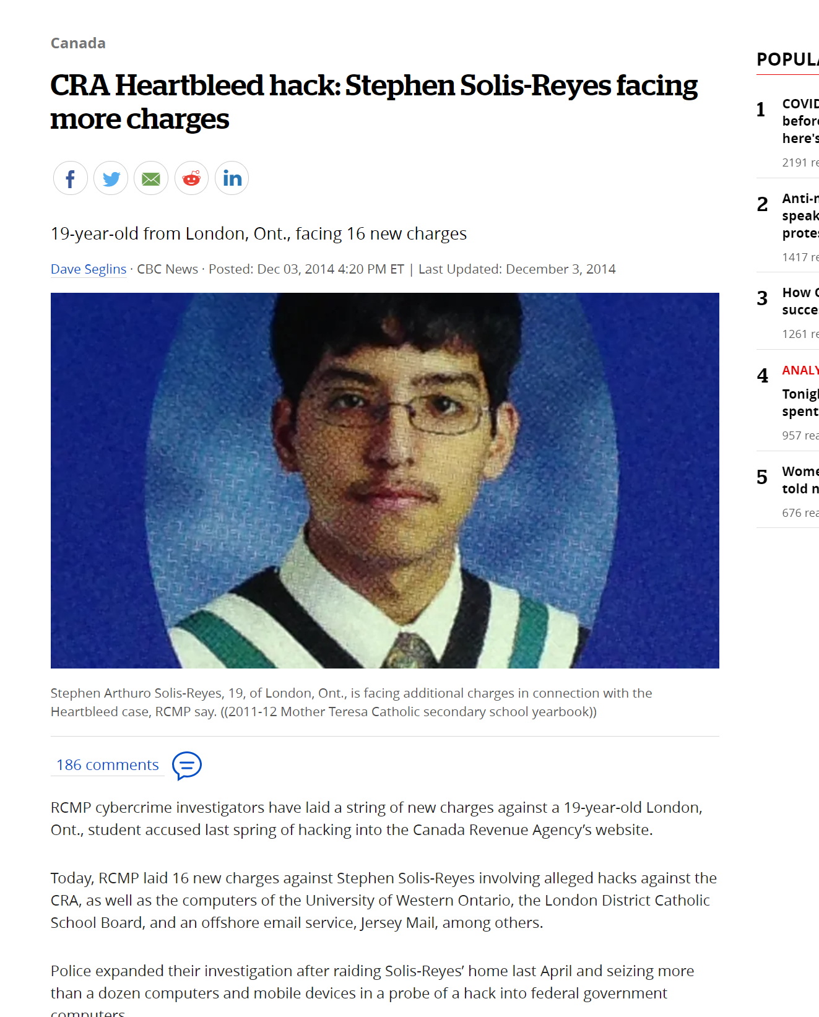
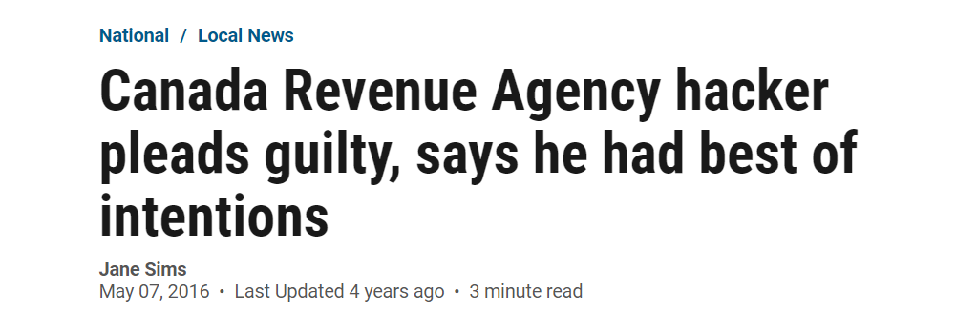
On Friday, now a top-notch computer science student at Western University, the 21-year-old pleaded guilty in an Ottawa courtroom to four charges.
The Crown dropped 13 other charges that, had be been convicted, could have sent him to prison for as long as 10 years.
For all of the national hubbub surrounding his activities in April 2014, Solis-Reyes was sentenced to an 18-month conditional sentence — the first four months under house arrest, the rest under supervision.
The defence gave the judge more than 20 reference letters from professors, teachers, friends and family who spoke of Solis-Reyes’ intellect and quiet, sensitive and respectful nature.
He’s carrying a 98.6 per cent grade average in his fourth year and has already been named to the dean’s honour list three times.
Central to the case, was Solis-Reyes’ intentions. Joseph told the judge it would have been easy for Solis-Reyes to sell the information or make money off it. None of that happened.
“He did it because he could, because he was capable of breaking into these national security places,” Joseph said, and that Solis-Reyes “has done the country a service” by exposing the flaws in the system.
On Friday, now a top-notch computer science student at Western University, the 21-year-old pleaded guilty in an Ottawa courtroom to four charges.
…
The Crown dropped 13 other charges that, had be been convicted, could have sent him to prison for as long as 10 years.
…
For all of the national hubbub surrounding his activities in April 2014, Solis-Reyes was sentenced to an 18-month conditional sentence — the first four months under house arrest, the rest under supervision.
…
The defence gave the judge more than 20 reference letters from professors, teachers, friends and family who spoke of Solis-Reyes’ intellect and quiet, sensitive and respectful nature.
He’s carrying a 98.6 per cent grade average in his fourth year and has already been named to the dean’s honour list three times.
…
Central to the case, was Solis-Reyes’ intentions. Joseph told the judge it would have been easy for Solis-Reyes to sell the information or make money off it. None of that happened.
“He did it because he could, because he was capable of breaking into these national security places,” Joseph said, and that Solis-Reyes “has done the country a service” by exposing the flaws in the system.
https://www.cbc.ca/news/canada/cra-heartbleed-hack-stephen-solis-reyes-facing-more-charges-1.2859416
https://ottawacitizen.com/news/local-news/canada-revenue-agency-hacker-pleads-guilty-says-he-had-best-of-intentions

Slide 28
Ethics - Summary
Core ethical points:
Safety of public is the most important consideration.
You may still have a lot of legal trouble for trying to keep public safe.
Intent matters in this – keeping public safe & trying to force a large reward can be tricky to do.
Access to devices you don’t have permission to access is almost always against the law & unethical.

